Slide 1
FED Talk: Section 508 Activities Update with GSA and the U.S. Access Board
March 19, 2024

Slide 2

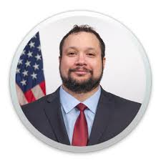


Today’s Presenters
Michael Horton
General Services Administration (GSA)
Alex Wilson
General Services Administration (GSA)
Tim Creagan
U.S. Access Board
Kathy Eng
U.S. Access Board

Slide 3
Agenda
About Us and the Week Ahead
Recent Government Actions Affecting Digital Accessibility
Ongoing Efforts to Advance Digital Accessibility
Additional Resources
Questions

Slide 4
Government-wide IT Accessibility Team from the General Services Administration (GSA) and the U.S. Access Board
GSA Government-wide IT Accessibility Team
Host Section508.gov and assist with technical support, guidance, and advice to agencies and individuals with questions and issues relating to implementation of Section 508 requirements.
Focus on providing support to federal agencies in the following primary areas:
Policy and Program Management
Accessible Acquisition
Content Creation
Accessible Design and Development
Accessibility Testing
Accessibility Training and Events
U.S. Access Board (USAB)​
Develop and issue the Section 508 accessibility standards.​
Provide technical assistance and training on Section 508 to federal agencies.​
Support the development of accessibility tools and best practices.​
Contribute to U.S. and worldwide accessibility communities in support of agency mission to promote equality for people with disabilities.

Slide 5
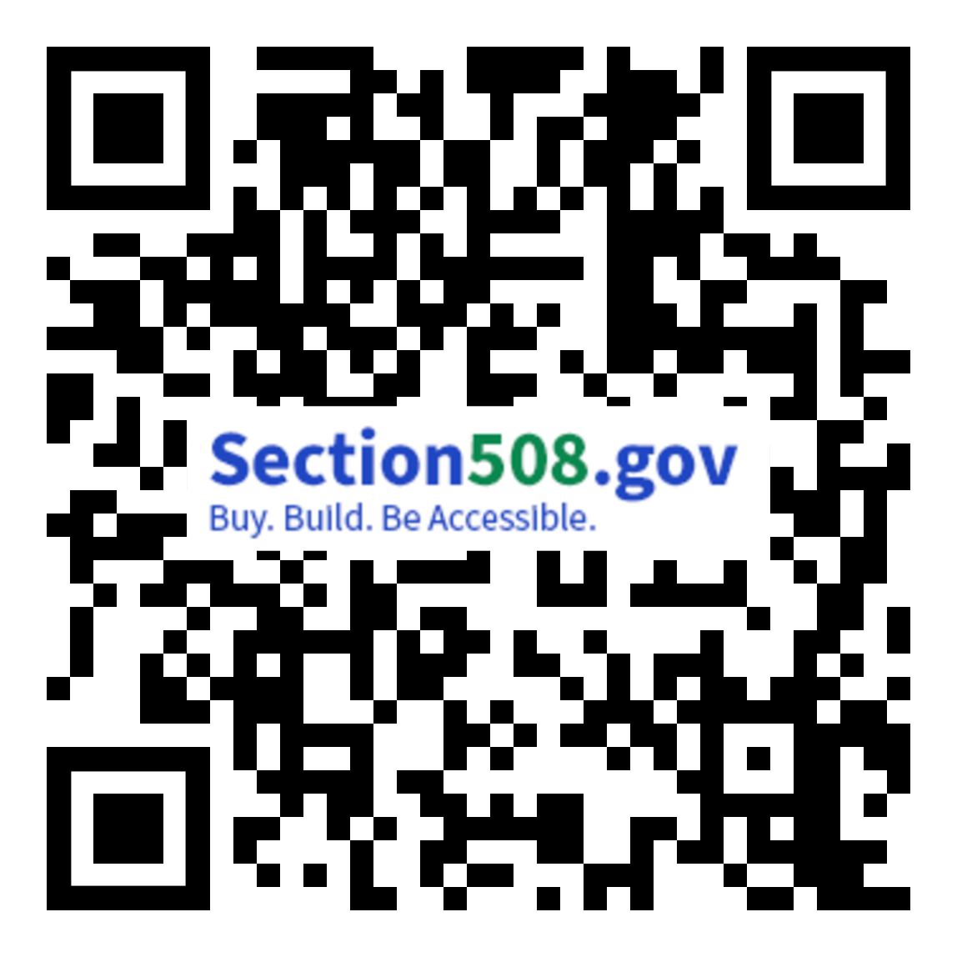
CSUN Sessions and Presentation Files
FED Talk - Section 508 Activities Update by USAB & GSA Tuesday at 10:20 a.m. in Grand GH
Section 508 ICT Testing Baseline Portfolio Wednesday at 10:20 a.m. in Grand GH
OpenACR: The Future of Accessibility Conformance Reporting Wednesday at 11:20 a.m. in Grand GH
Birds of a Feather Thursday at 12:00 p.m. in Platinum 9-10 Ballroom
Analytical Approach to the Governmentwide Annual Assessment Thursday at 3:20 p.m. in Orange County 1-2
Introduction to the Accessibility Requirements Tool (ART) Thursday at 4:20 p.m. in Grand JK
Section508.gov/csun2024/

Slide 6
Recent Government Actions Affecting Digital Accessibility

Slide 7

Congressional Actions
Unlocking the Virtual Front Door (Senate Aging Committee)
An examination of federal technology’s accessibility for people with disabilities, older adults and veterans
Lays out four primary findings and plans to address the lack of digital accessibility across the federal government
Section 752 of the 2023 Congressional Authorizations Act (CAA)
Directs Office of Management and Budget (OMB) in consultation with GSA and the U.S. Access Board to release criteria for organizations to assess their own digital accessibility
Directs GSA in coordination with OMB to create a report based on the findings from these criteria

Slide 8
OMB Memoranda
M23-22: Delivering a Digital First Public Experience
Implementation guidance for 21st Century Integrated Digital Experience Act (IDEAct)
States agencies must design and develop high-quality digital experiences that are simple to use, seamless across journeys, and secure by design
M24-08: Strengthening Digital Accessibility and the Management of Section 508 of the Rehabilitation Act
Provides guidance to help agencies advance digital accessibility by maintaining an accessible federal technology environment, promoting accessible digital experiences, and continuing the implementation of accessibility standards in accordance with Section 508 of the Rehabilitation Act of 1973, as amended

Slide 9
Ongoing Efforts to Advance Digital Accessibility

Slide 10
The Governmentwide Accessibility Assessment: Mandate
In Section 752 of the 2023 Congressional Appropriations Act, Congress stipulated that Office of Management and Budget (OMB), GSA and the USAB report on governmentwide accessibility. The following items were mandated:
100 days after enactment, provide questions/metrics agencies must report on
225 Days after enactment (NLT 11 August), agencies respond
365 days after enactment (NLT 29 December), provide the following:
A comprehensive assessment by agency and governmentwide generally of compliance to accessibility standards
A detailed description of actions and efforts GSA took to support compliance at agencies over the past year and planned efforts in the next year
A list of recommendations to Congress to help support accessibility compliance
Please attend our deep dive session on the 2023 Governmentwide Accessibility Assessment on Thursday at 3:20 p.m. in Orange County 1-2

Slide 11
The Governmentwide Accessibility Assessment: Findings
The assessment team collected responses to the established criteria from 249 agencies. Using several modes of analysis, the team determined:
Accessibility conformance was relatively low on average
While many respondents tested for conformance of information and communications technology (ICT), mixed results were seen across government
Conformance of top-viewed ICT was relatively low across government
Program maturity was relatively low and could be improved across government
Key heavily used ICT was either not tested or did not conform to accessibility standards
Please attend our deep dive session on the 2023 Governmentwide Accessibility Assessment on Thursday at 3:20 p.m. in Orange County 1-2

Slide 12
Technology Accessibility Playbook

Slide 13
Section508.gov Body of Knowledge and the Technology Accessibility Playbook
The governmentwide IT accessibility team is currently identifying gaps and additional stakeholder needs that should be addressed on Section508.gov. This includes the technology accessibility playbook with updates such as:
Providing a “model” organization that depicts best practices for accessibility across an organization
Updating outdated and no longer relevant content
Expanding sections to include more specific examples of accessibility in practice and more specific and practical steps to create an accessible environment on your own

Slide 14
IT Accessibility Policy Framework

Slide 15
IT Accessibility Policy Framework: Concept
1. Policy Framework Overview & Introduction Materials
2. Policy Assessment Templates and Instruction Guides
3. Recommended Accessibility-Related Language by Topic & Subtopic
IT Accessibility Policy Analysis Framework

Slide 16





IT Accessibility Policy Framework:
Next Steps
Garner external stakeholder feedback on the tool
Update recommended language, templates and analysis materials as required based on feedback
Identify pilot partners
Brief to partners, align pilot assessments, and assist in pilot assessments as required
Iterate and revise framework based on pilot results

Slide 17
Accessible Acquisition Tools: Accessibility Requirements Tool (ART) and Solicitations Review Tool (SRT)

Slide 18
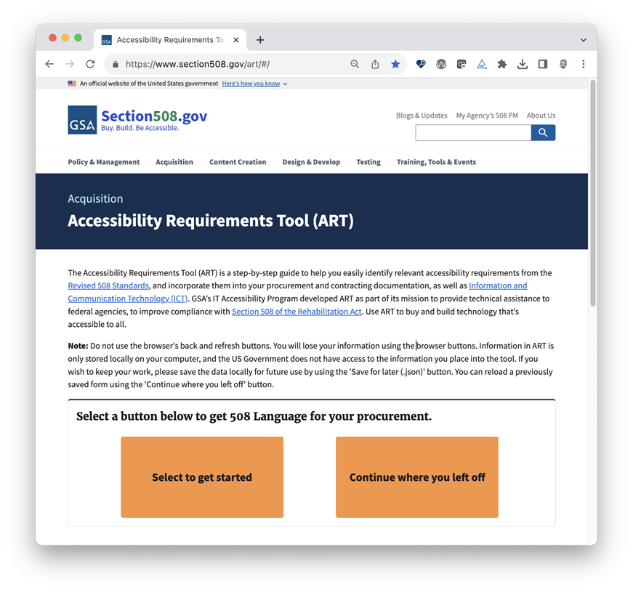
The Accessibility Requirements Tool
(ART)
ART is a step-by-step guide to help you easily identify relevant accessibility requirements from the Revised 508 Standards and incorporate them into your procurement
Selected recent ART updates:
Reduced time to create a procurement flow by 50%
Ability to save completed form in multiple formats
Upgraded from Drupal7 to most recent framework, Angular 15
Opportunity to continue from where user left off using JSON file
Ability to be integrated with other platforms and software
Please attend our deep dive session: Introduction to the Accessibility Requirements Tool (ART) - on Thursday at 4:20 p.m. in Grand JK.

Slide 19
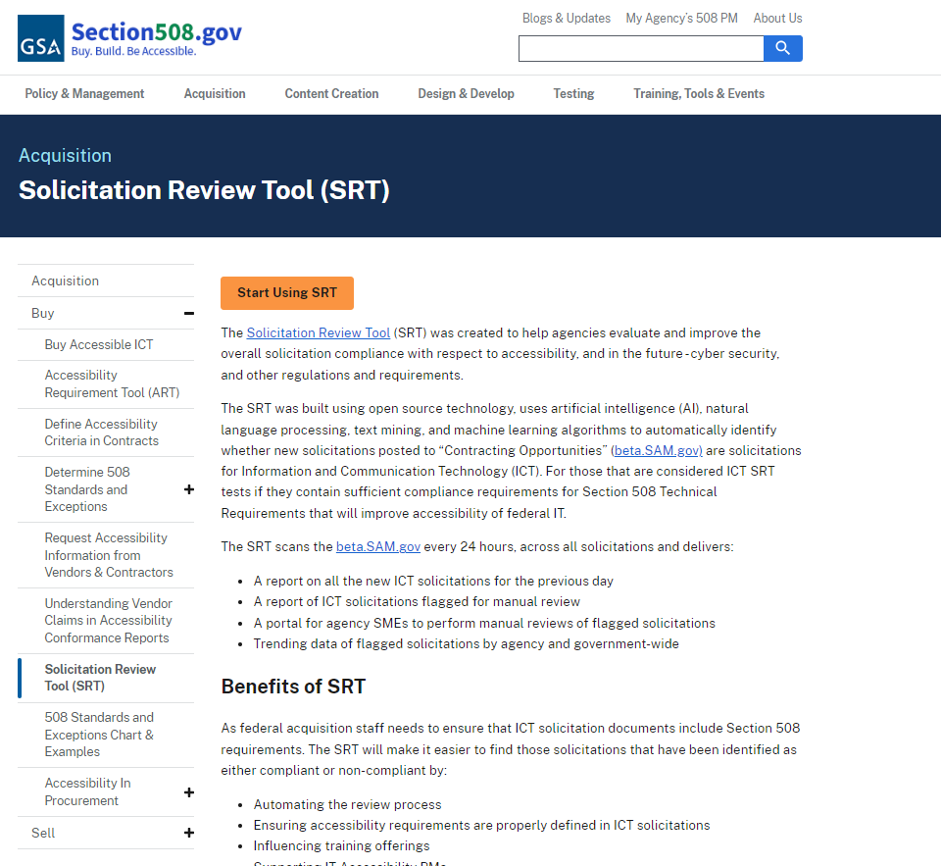
The Solicitation Requirements Tool
(SRT)
SRT uses artificial intelligence (AI), natural language processing, text mining, and machine learning algorithms to automatically identify whether new solicitations are ICT solicitations and, if so, tests if they contain sufficient compliance requirements for Section 508 Technical Requirements.
Selected recent SRT updates:
Reconfigured user interface
Increased security measures
Migrated open source repositories
Notes:
Over the past year, the SRT development team has overhauled and reconfigured the tool’s User Interface and User Experience; increased security measures and removed all vulnerabilities around SRT updated machine-learning algorithms for natural language processing; and cleaned up and migrated all open source repositories for easier public use.

Slide 20
The ICT Baseline and
Trusted Tester

Slide 21
ICT Baseline
Section 508/WCAG 2.0 AA
What to Test
ICT Testing Baseline
Establishes the foundation for consistent test results
Will eventually include Baselines for all ICT covered by Section 508
Completed: Web
Draft: Electronic Documents
Planned: Software, Hardware, etc.
Please attend our deep dive session: Section 508 ICT Testing Baseline Portfolio on Wednesday at 10:20 a.m. in Grand GH.

Slide 22
Trusted Tester
The Department of Homeland Security’s (DHS) Trusted Tester Process is a manual test approach that aligns with the ICT Testing Baseline and provides repeatable and reliable conformance test results. DHS offers training and formal accessibility testing certification for using the DHS Trusted Tester Process. Recent Trusted Tester updates include:
Refresh TT training to align with upcoming baseline release
Refine TT testing methodology

Slide 23
OpenACR, OpenACR Editor and the ACR Repository

Slide 24
The OpenACR Portfolio
The OpenACR data schema for a machine-readable ACR:
Buyers can more easily compare accessibility of different solutions
Managers gain insights into potential interface limitations
Executives more easily assess risks associated with accessibility issues in portfolio of ICT products
The OpenACR Editor is a user-friendly interface to:
Create machine-readable Accessibility Conformance Reports (ACRs) in the OpenACR format
Validate and edit previously created ACRs
Export and share machine-readable data
View ACR reports in HTML
Try Now: acreditor.section508.gov
The OpenACR repository will be a platform for users to store, compare and update information for ACRs. This repository will:
Provide the ability to see all products and ACRs in a comprehensive repository
Allow users the ability to compare ACR reports between products
Provide search functionality

Slide 25
Additional Resources

Slide 26
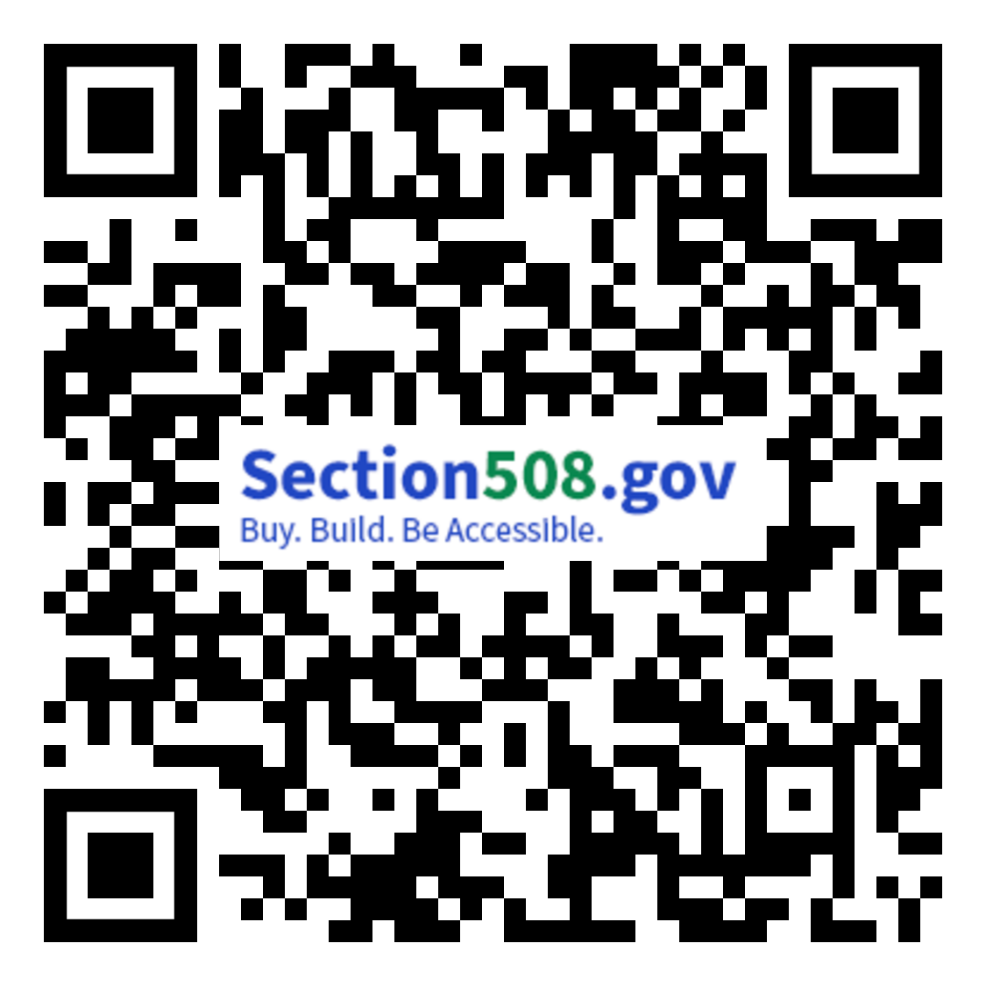
Additional Resources Governmentwide Accessibility Assessment
The web version of the report is available at: Section508.gov/2023-congressional-report/
A downloadable version of the report, respondent data, and other content related to the Assessment is available at Section508.gov/2023-congressional-report-downloads/, including:
FY 23 Governmentwide Section 508 Assessment (PDF) as transmitted to Congress on December 29, 2023
Reporting Entity Response Data for FY23 Government-wide Section 508 Assessment (CSV) and (JSON)
Regression Results for FY23 Governmentwide Section 508 Assessment
FY23 Governmentwide Section 508 Assessment Data Dictionary
Data Validation for FY23 Governmentwide Annual Assessment
Section508.gov/2023-congressional-report/
Notes:
The web version of the report is available at: https://www.section508.gov/manage/section-508-assessment/2023/message-from-gsa-administrator/
A downloadable PDF version of the report is available at: https://assets.section508.gov/files/reports/cr-2023/FY%2023%20Governmentwide%20Section%20508%20Assessment%20Report.pdf
All response data is available at: https://www.section508.gov/manage/section-508-assessment/2023/assessment-data-downloads/
All FY23 criteria and instructions are available at: https://www.section508.gov/manage/section-508-assessment/criteria-01/

Slide 27
Contact Information
Contact the GSA Government-wide IT Accessibility Program:
Visit our Contact Us page at https://www.section508.gov/contact-us/
Contact us via email at section.508@gsa.gov
Visit our homepage at section508.gov
Contact the U.S. Access Board:
Section 508 Standards (https://www.access-board.gov/ict/)
Email: 508@access-board.gov
Phone: (202) 272-0080, extension 3 (voice)
Notes:
Contact the GSA Government-wide IT Accessibility Program:
Visit our Contact Us page at https://www.section508.gov/contact-us/
Contact us via email at section.508@gsa.gov
Contact the U.S. Access Board:
Access Board Contact Us page (https://www.access-board.gov/contact/)
Email: 508@access-board.gov
Phone: (202) 272-0080, extension 3 (voice)
Fax: (202) 272-0081

Slide 28
CSUN Sessions and Presentation Files (Reprise)
FED Talk - Section 508 Activities Update by USAB & GSA Tuesday at 10:20 a.m. in Grand GH
Section 508 ICT Testing Baseline Portfolio Wednesday at 10:20 a.m. in Grand GH
OpenACR: The Future of Accessibility Conformance Reporting Wednesday at 11:20 a.m. in Grand GH
Birds of a Feather Thursday at 12:00 p.m. in Platinum 9-10 Ballroom
Analytical Approach to the Governmentwide Annual Assessment Thursday at 3:20 p.m. in Orange County 1-2
Introduction to the Accessibility Requirements Tool (ART) Thursday at 4:20 p.m. in Grand JK
Section508.gov/csun2024/

Slide 29
Questions?

